Slide 1
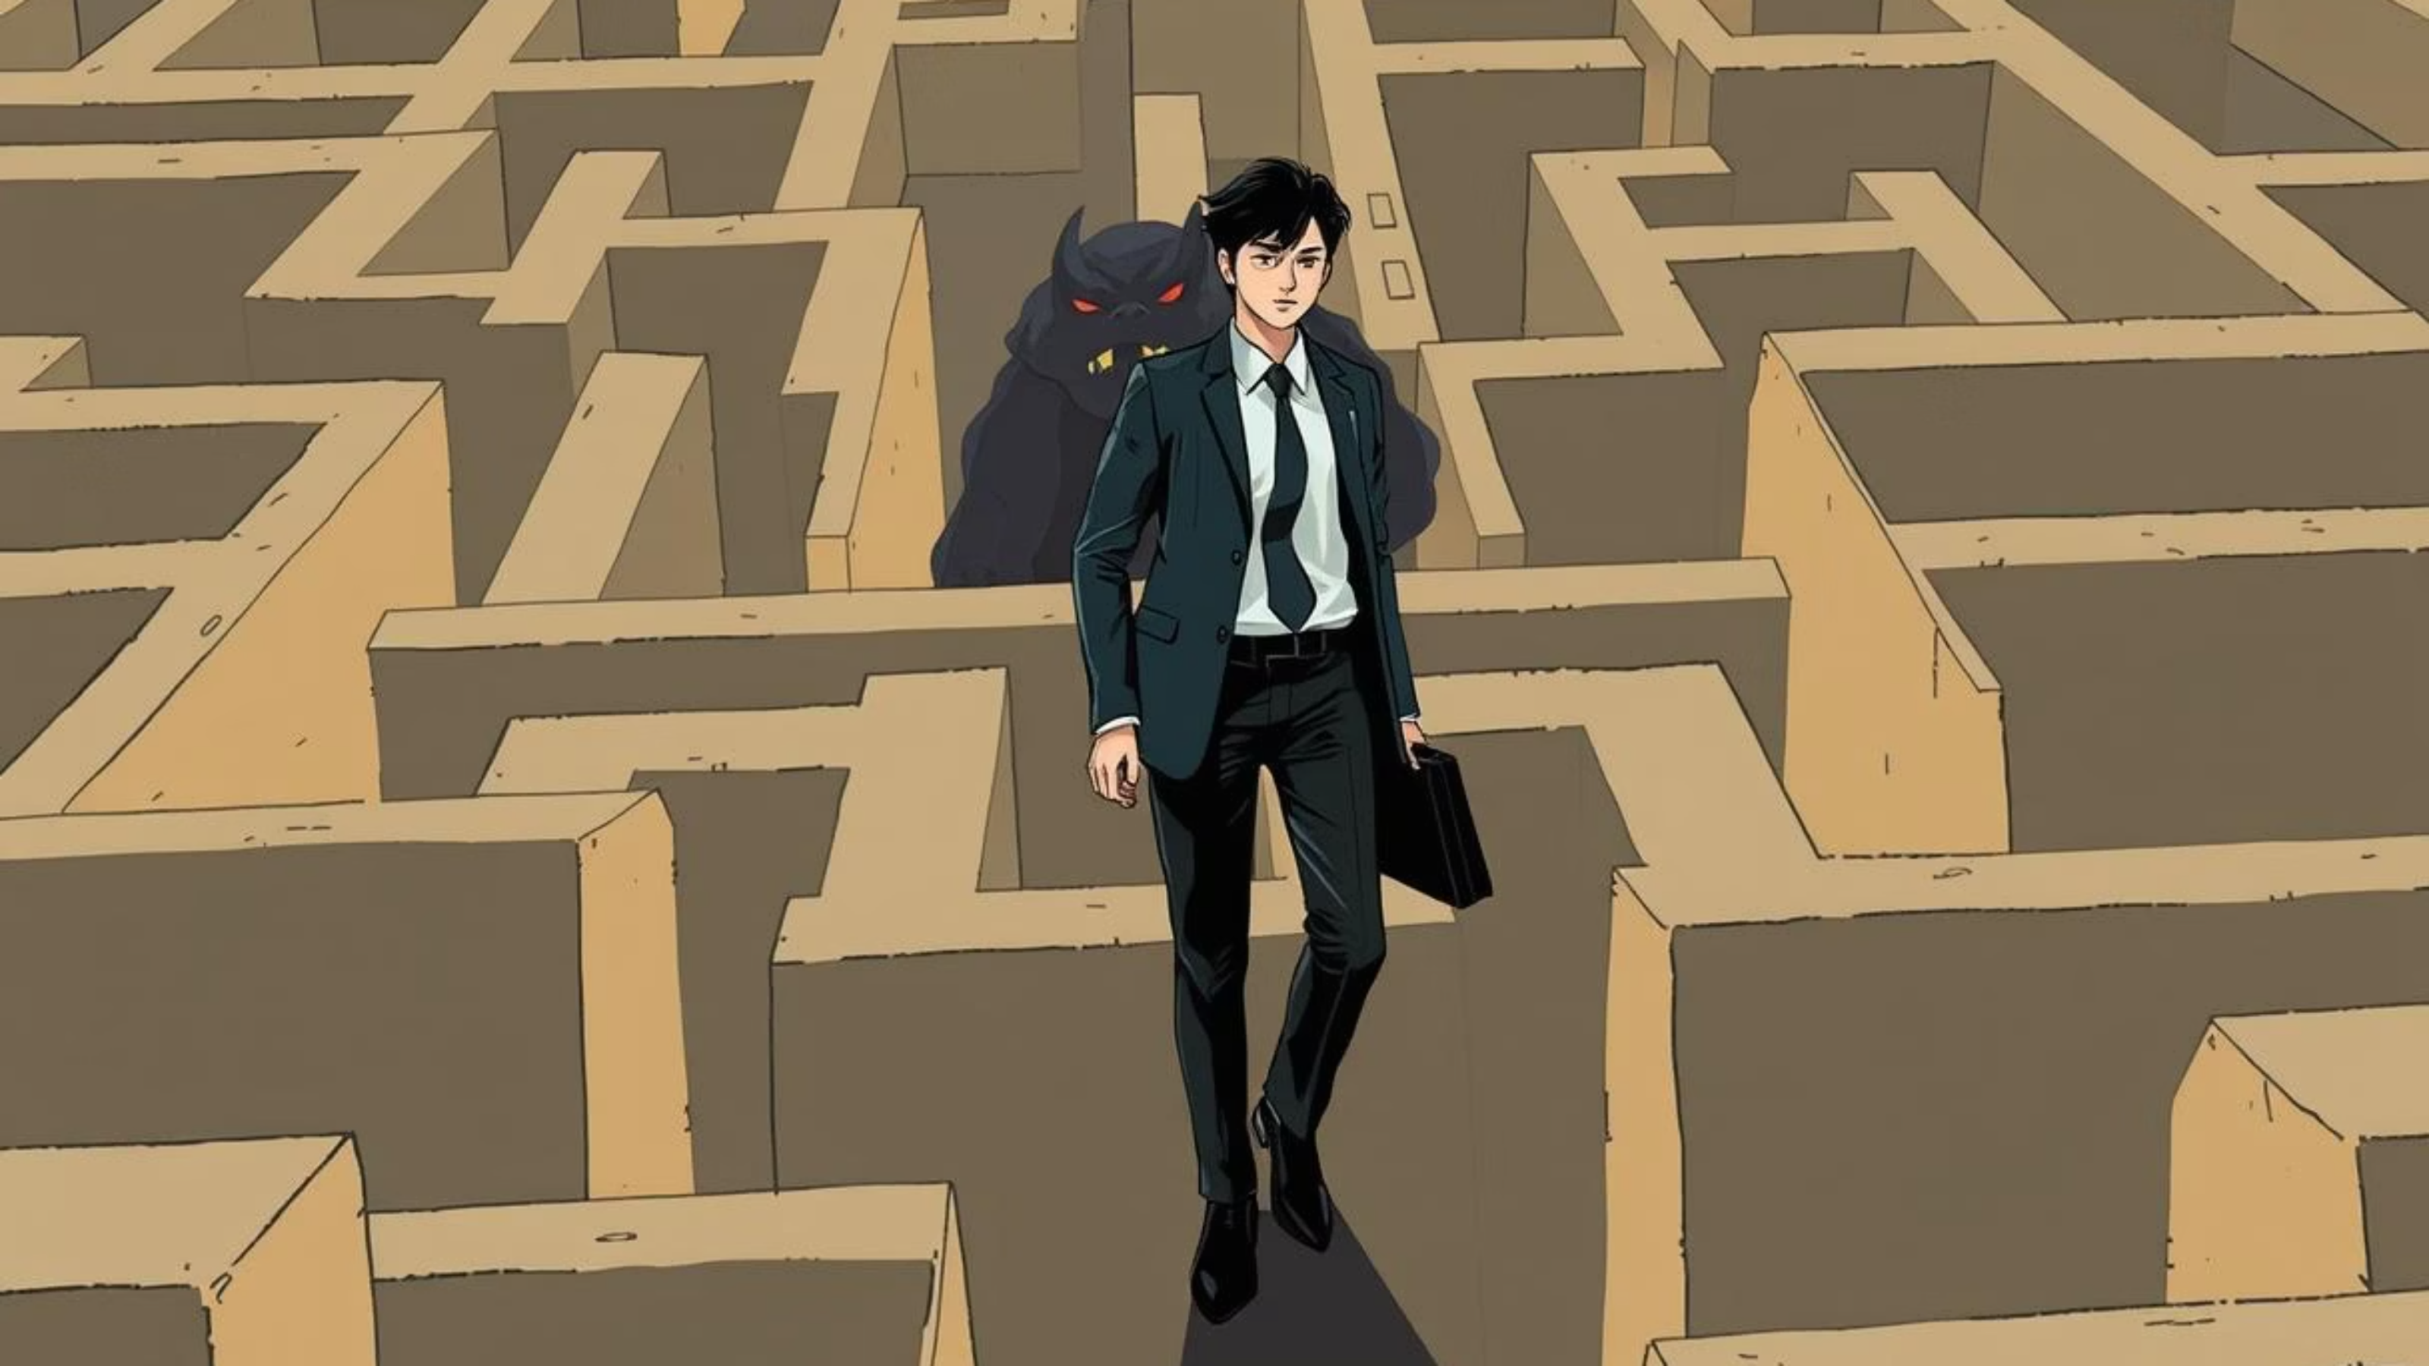
Maze Game – Technical Documentation
Maze Game is a Python game built using Pygame. The player navigates through a procedurally generated maze while being chased by an AI-controlled monster that uses the A* pathfinding algorithm. The game features fog of war, smooth camera movement, configurable settings, background music, and a fullscreen UI.
Developers
George Assem Aziz 2301325
Marawn Montaser Fakhry 2301343
Ziad Ashraf Saban 2301320
Ziad Ashraf Saad 2301279
Amir Abdelrahim Ahmed 2300789

Slide 2
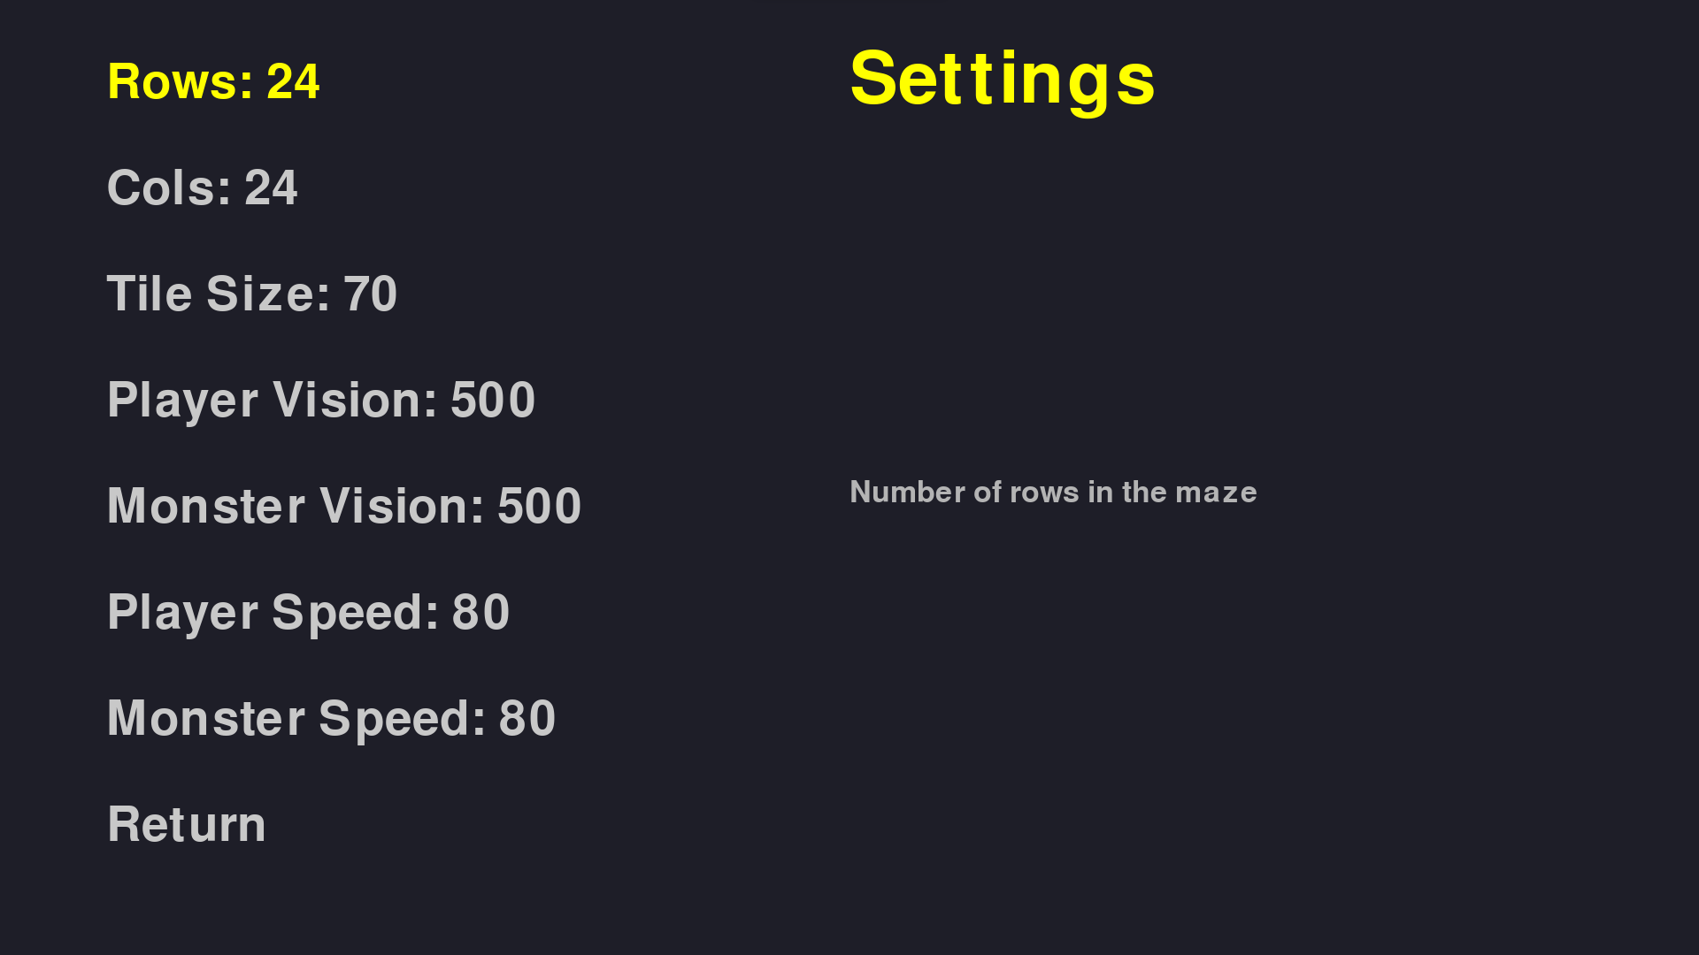
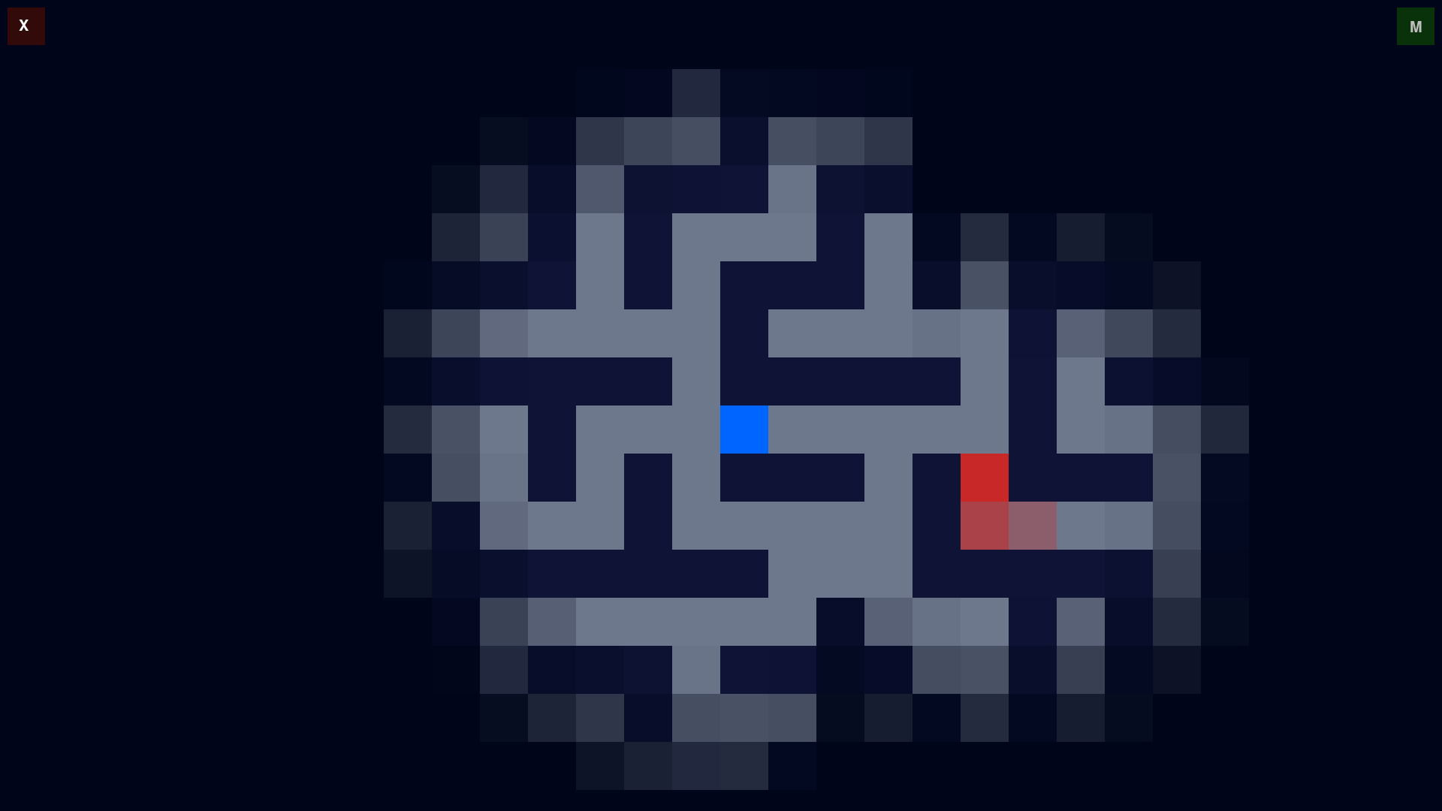
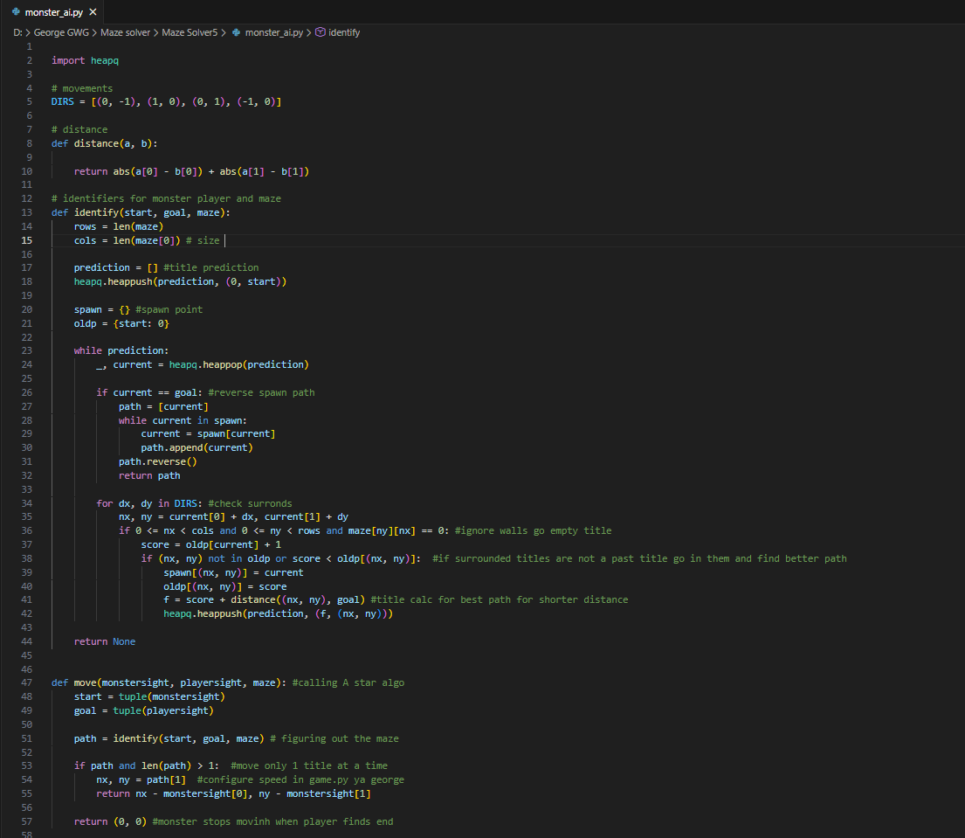
Overview
The project is divided into three main components:
menu.py
game.py
monster_ai.py
Game configuration menu
Core gameplay loop and rendering
Monster pathfinding and AI logic

Slide 3


Game Features
Procedural Maze Generation
A* Pathfinding AI
With loops for increased complexity.
Monster chases the player using an efficient algorithm.
Fog of War
Smooth Camera Movement
Smooth vision transitions for an immersive experience.
Camera is always centered on the player.
Fullscreen, Borderless Window
Configurable Settings
Optimized for an uninterrupted gaming experience.
Adjust maze size, tile size, and vision radius.
Background Music
Tranquil 🎶
by. Jeorje
UI Buttons
With a convenient mute toggle.
Exit and mute buttons for easy control.

Slide 4
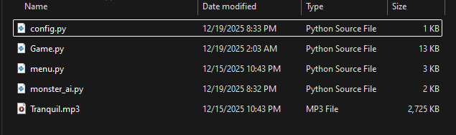
File Structure
maze_game/ │ ├── menu.py # Settings menu ├── game.py # Main game logic ├── monster_ai.py # AI pathfinding logic ├── config.py # Auto-generated configuration file ├── Tranquil.mp3 # Background music

Slide 5
menu.py – Settings Menu
The menu system allows the player to configure game parameters before starting the game.
Purpose
Configurable Settings
Adjust maze size and gameplay parameters
Setting
Description
Save settings to config.py
Launch the main game
Rows
Number of maze rows
Cols
Number of maze columns
Vision
Player visibility radius (tiles)
Tile Size
Size of each maze tile in pixels
Controls
Up / Down Arrow – Navigate settings
Left / Right Arrow – Modify values
Enter – Save configuration and start game
Esc – Exit menu
Configuration Saving
The save_config() function writes the selected values to config.py, which is imported by game.py at runtime.

Slide 6
game.py – Core Gameplay
This file contains the main game loop, rendering logic, player movement, and interactions.
01
02
03
Initialization
Maze Generation
Start and Exit Points
Initializes Pygame and audio mixer. Loads background music and starts looping playback. Loads configuration values from config.py.
The maze is generated using a depth-first search (DFS) algorithm with bias against long straight paths and additional random loops for complexity. Functions involved: generate_maze() – Creates the main maze structure, add_loops() – Adds alternative paths.
Start position is fixed at (0, 0). Exit is determined using Breadth-First Search (BFS) to find the farthest reachable tile.
04
05
06
Player Movement
Monster Behavior
Camera System
Controlled using WASD or Arrow Keys. Movement is tile-based and time-delayed (MOVE_DELAY). Player position is tracked along with two ghost positions for visual trailing.
Monster starts at the maze exit. Moves toward the player using A* pathfinding. Speed is controlled by monsterspeed. Leaves a short visual trail.
Smooth camera interpolation toward the player. Camera movement is clamped to maze boundaries. Fog camera lags slightly for cinematic effect.
07
08
09
Fog of War
UI Elements
Win and Lose Conditions
Darkness overlay covers unexplored areas. Circular vision radius around player. Smaller vision radius around monster. Smooth fade-out at edges.
Mute Button (Top-Right) – Toggles background music. Exit Button (Top-Left) – Closes the game.
Win: Player reaches the exit tile. Lose: Monster reaches the player.

Slide 7
monster_ai.py – AI & Pathfinding
This module implements the monster’s decision-making logic.
Algorithm Used: A*
The monster uses the A* search algorithm, which combines:
Actual path cost from the start (g)
Heuristic distance to the goal (h)
Heuristic Function
abs(x1 - x2) + abs(y1 - y2)
Manhattan distance is used since movement is grid-based.
Core Functions
distance(a, b) – Heuristic calculation
identify(start, goal, maze) – Computes optimal path
move(monstersight, playersight, maze) – Returns one-tile movement direction
The monster only moves one tile per update to allow speed control in game.py.

Slide 8
Controls Summary
Action
Key
Move
WASD / Arrow Keys
Mute Music
M
Exit Game
ESC or Exit Button

Slide 9

Future Improvements
Multiple Monsters
With different AI behaviors.
Player Abilities
Sprint, hide, traps, and more.
Difficulty Scaling
Adjust game difficulty dynamically.
Mini-map or Memory-based Fog
Enhanced navigation and exploration.
Sound Effects and Animations
For a richer sensory experience.

Slide 10
Dependencies and Conclusion
Dependencies
Python 3.x
Pygame
Install Pygame:
pip install pygame
Ensure all project files are in the same directory.
Run the menu file using: python menu.py
Adjust settings if desired and press ENTER to start the game.

Slide 11
Testing Results
• Maze Validity Test: Ensured all generated mazes are solvable.
• Monster Pathfinding Test: Verified that the monster successfully follows the player.
• Collision Test: Confirmed correct behavior when the player is caught or reaches the exit.
• Performance Test: Maintained stable performance at 60 FPS.
All tests produced the expected results without critical errors.
Conclusion
This project demonstrates procedural content generation, real-time pathfinding AI, and advanced visual effects using Pygame. The modular structure allows easy expansion and experimentation with AI behaviors and gameplay mechanics.

